Slide 1
WEB USABILITY PRINCIPLES

Slide 2
KEY PRINCIPLES OF WEBSITE USABILITY
What is website usability
The 5 principles of web usability
Difference between Usability & Accessibility
Testing for usability
Usability is a crucial part of great website design

Slide 3

What is Website Usability
Website usability is a feature of websites and a way of designing them that focuses on the user’s needs. It utilizes user-centric design processes to ensure that websites are efficient and easy to use for the people who actually use them, rather than the people who designed them.
However it is sometimes complex to make your website usable and simple.
Clarity and utility are the two goals of website usability, and designers need to prioritize both. In other words, web designers are tasked with making websites that don’t just look appealing, but work exactly how users expect them to work, which is no small task for even the most experienced designer.

Slide 4
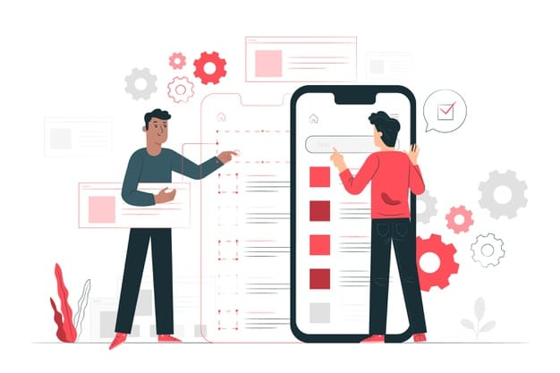
The 5 principles of web usability
Availability & Accessibility
Clarity
Recognition
Credibility
Relevance

Slide 5
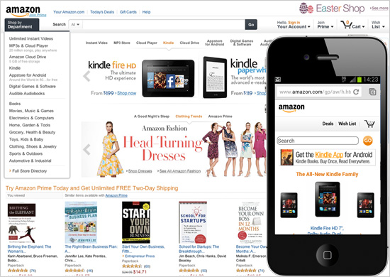
Availability & Accessibility
These terms are simply how easy it is to access your website. Your website’s availability can be affected by the web hosting platform you use and by how compatible it is with the devices users are accessing it with.
Here are a few of the basics of availability and accessibility:
Server uptime – It’s important to ensure your visitors don’t get an error trying to load your site. Invest in good hosting. SO it is important get a good web host that you can depend on.
Broken links – Double check that there are no dead links on your site. SEO tools like Arhefs and Screaming Frog will crawl your site for you and find all the broken links.
Mobile responsiveness – Make sure your site can handle different screen sizes and slow connections. Google has also moved to a “mobile-first” index which means they index the mobile versions of sites. So a great mobile site will help you get better search results.

Slide 6
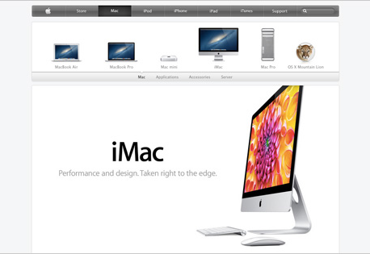
Clarity
Clarity is the core of website usability. Visitors come to your site with specific goals in mind, and certainly those goals don’t include checking out your web design skills!
If your website’s design distracts or confuses visitors, they’ll either need more time to find what they came for, or they might forget their initial goal altogether and leave. In either case, they’re leaving dissatisfied and unlikely to come back.

Slide 7
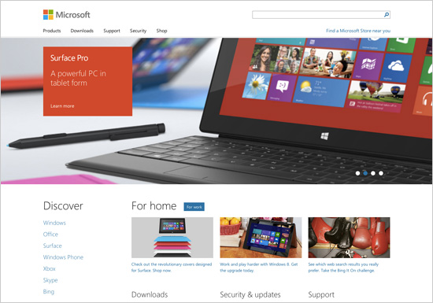
Recognition
Recognition is a way of describing the learning process users undertake when they visit a new site. You might not feel that your website needs to be studied to be used, but in reality, all sites require at least a few seconds of assessment before a user can interact with them.
The vast majority of users will, for instance, need to navigate back to your homepage at some point, and most will look for a logo in the top left corner of their screen to do so. If your website works differently, they’ll have to spend a few seconds learning how to get back to the homepage. When designing for usability, strive to keep this learning curve as short as possible.

Slide 8
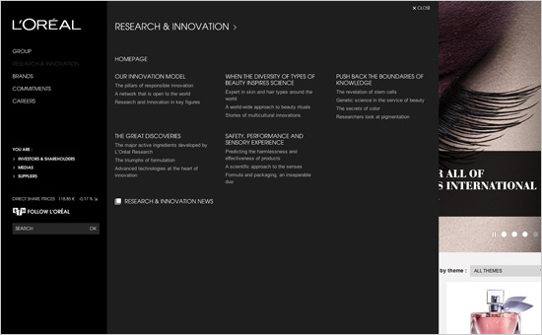
Credibility
Even if customers can easily find the content or functionality they’re looking for, if they don’t trust it, the website is worse than useless for them. There are a lot of ways to demonstrate your credibility through your website design, like being transparent about your business and goals.

Slide 9
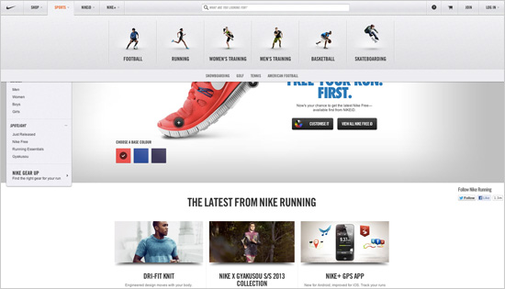
RELEVANCE
Relevance is perhaps the most complex issue in usability because it describes whether the content that your customers see on your site is engaging. Creating engaging content involves carefully defining your target audience, determining what they want and meeting their needs as clearly as possible.

Slide 10
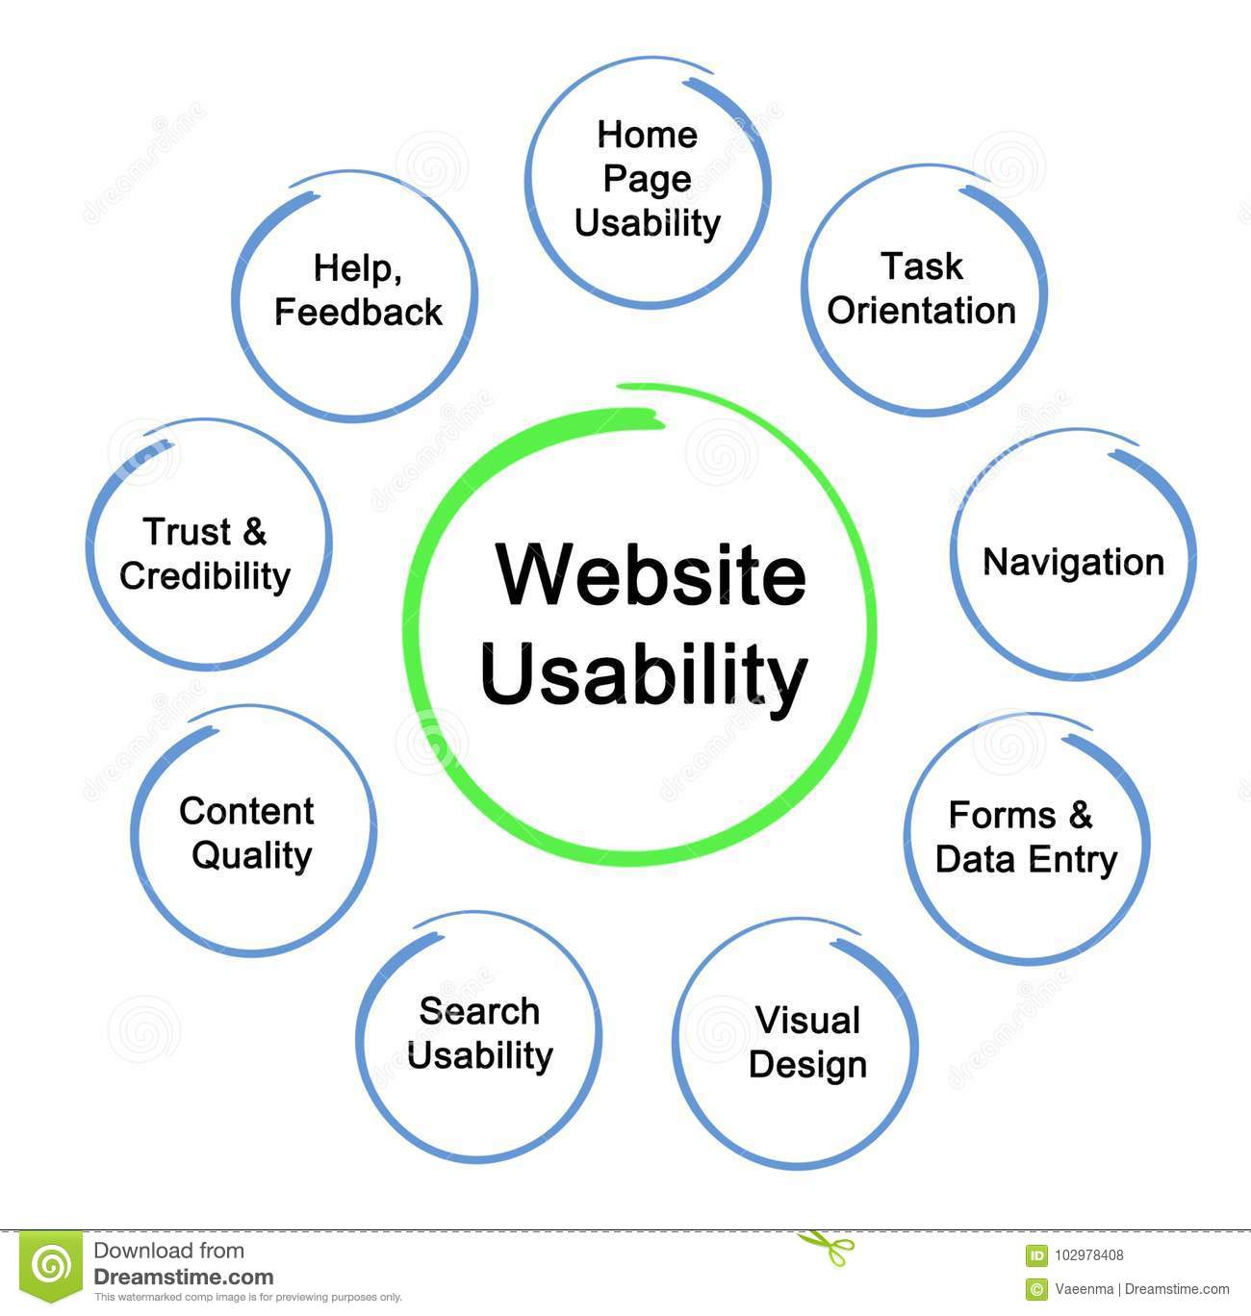
Usability & Accessibility
USability
Usability, as a practice and a feature of web design, shares some elements with the concept of accessibility. But there is a key difference: usability relates to all users, whereas accessibility generally refers to those users who have a disability of some type.
Accessibility
Accessibility, means designing websites and apps in a way that makes them accessible for people with disabilities. This can mean making the website compatible with various assistive devices or simply using thoughtful design. Worldwide, approximately one billion people, or 15 percent of the world’s population, live with a disability. By making your website accessible, you avoid potentially alienating users.

Slide 11
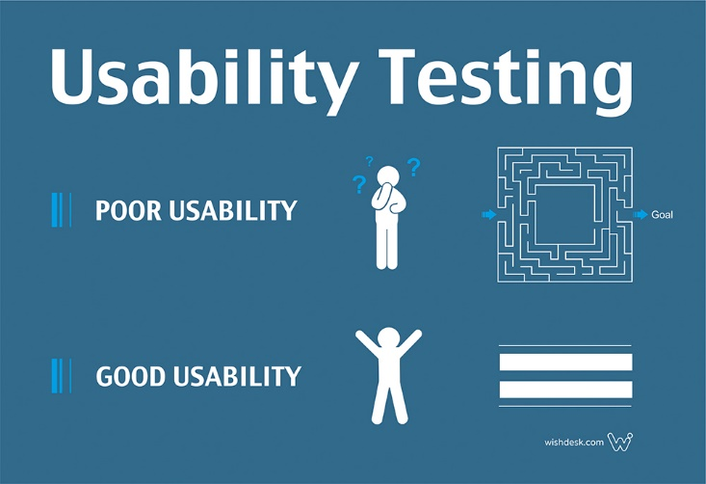
TESTING FOR USABILITY
Here’s the key point to remember when it comes to usability testing: good design is a process, not an event. Organizations need to continually test their sites’ usability and use their findings to make their websites even better.
You can’t make assumptions about the choices your designers and developers made during the building process, you’ve got to test them. Just because the structure they used looked good on paper doesn’t mean the end user will have a seamless experience.
For this reason, usability testing is the first step in the web design process, and also the last. Usability testing generally involves recruiting volunteers and asking them to use your website.
By monitoring their clicks, mouse movements and behavior, you can identify potential pain points or flaws in the design. The participant can vocalize any problems they had and voice their feedback as well.

Slide 12
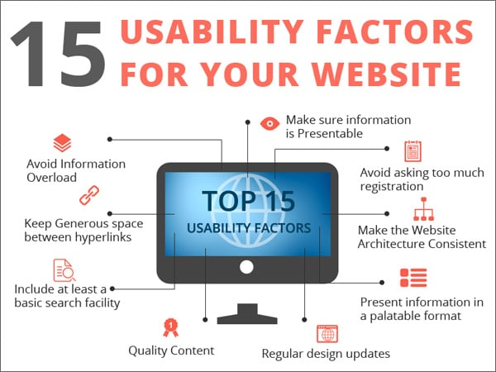
USABILITY IS A CRUCIAL PART OF GREAT WEBSITE DESIGN
Website usability is not optional. It’s a measure that can be applied to any website and describes how effective your website is and whether your website is an effective investment.
This simple point can be easily forgotten. Your website design might work well for managers when they test it, but they know what your business does and how it works.
It might be a totally different story for your users. Re-focusing your design on your users, and on what they want to achieve, can make your website more usable. In other words, making your website easier to use means that more people will use it. And making it easier to use is best done by working in collaboration with a web designer.

